Slide 1
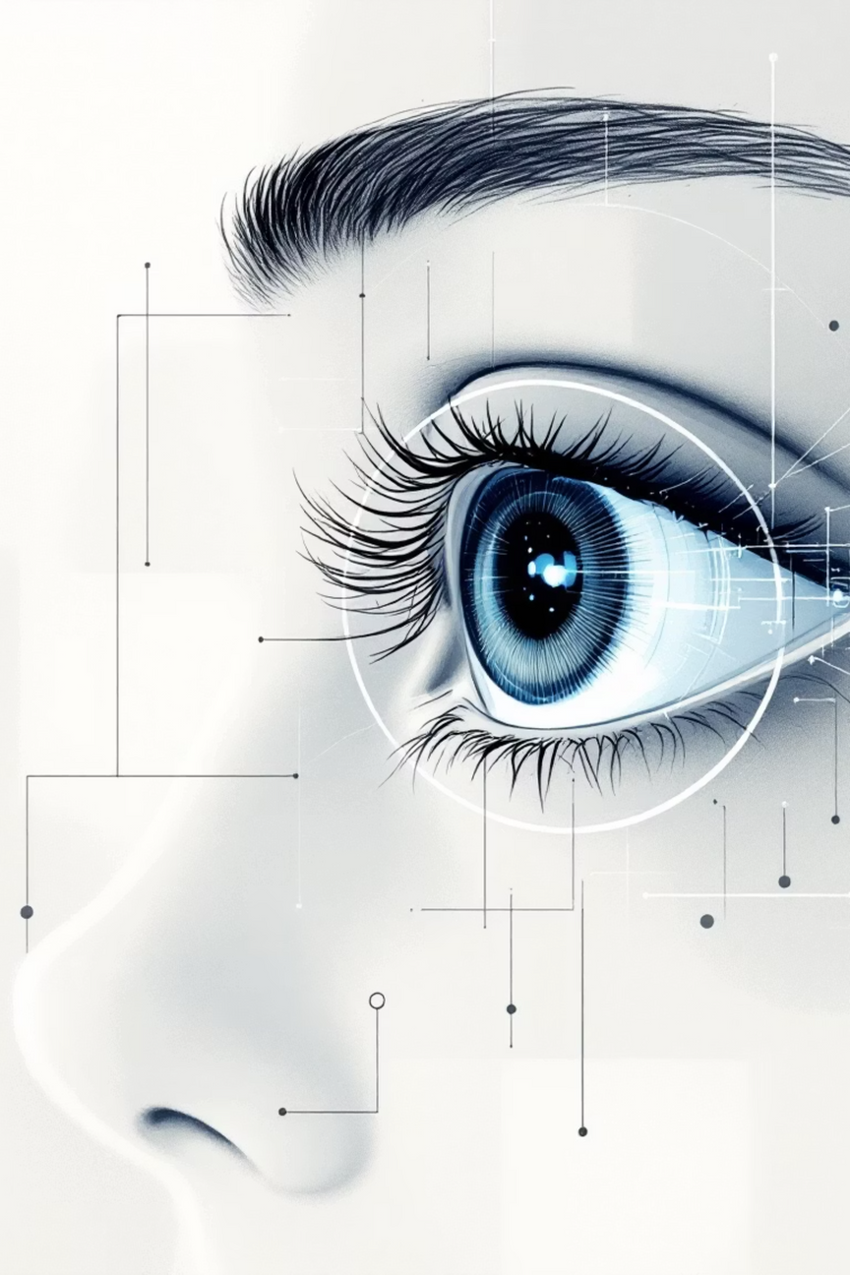
RETINAL DISEASE CLASSIFICATION USING CONVOLUTIONAL NEURAL NETWORKS
Course: ATI | Project 3
Group Members: Trần Quang Huy Nguyễn Thùy Anh Mộc Khánh Duy
Date: December 2025
Notes:
1

Slide 2
Agenda
1
2
Problem Formulation
Inputs and Outputs
3
4
Data Preparation & Visualization
Optimization Techniques Analysis
5
6
Neural Network Model Architecture
Performance Evaluation
7
8
Inference on New Data
Conclusion
Notes:
2

Slide 3
Problem Formulation
Notes:
2

Slide 4
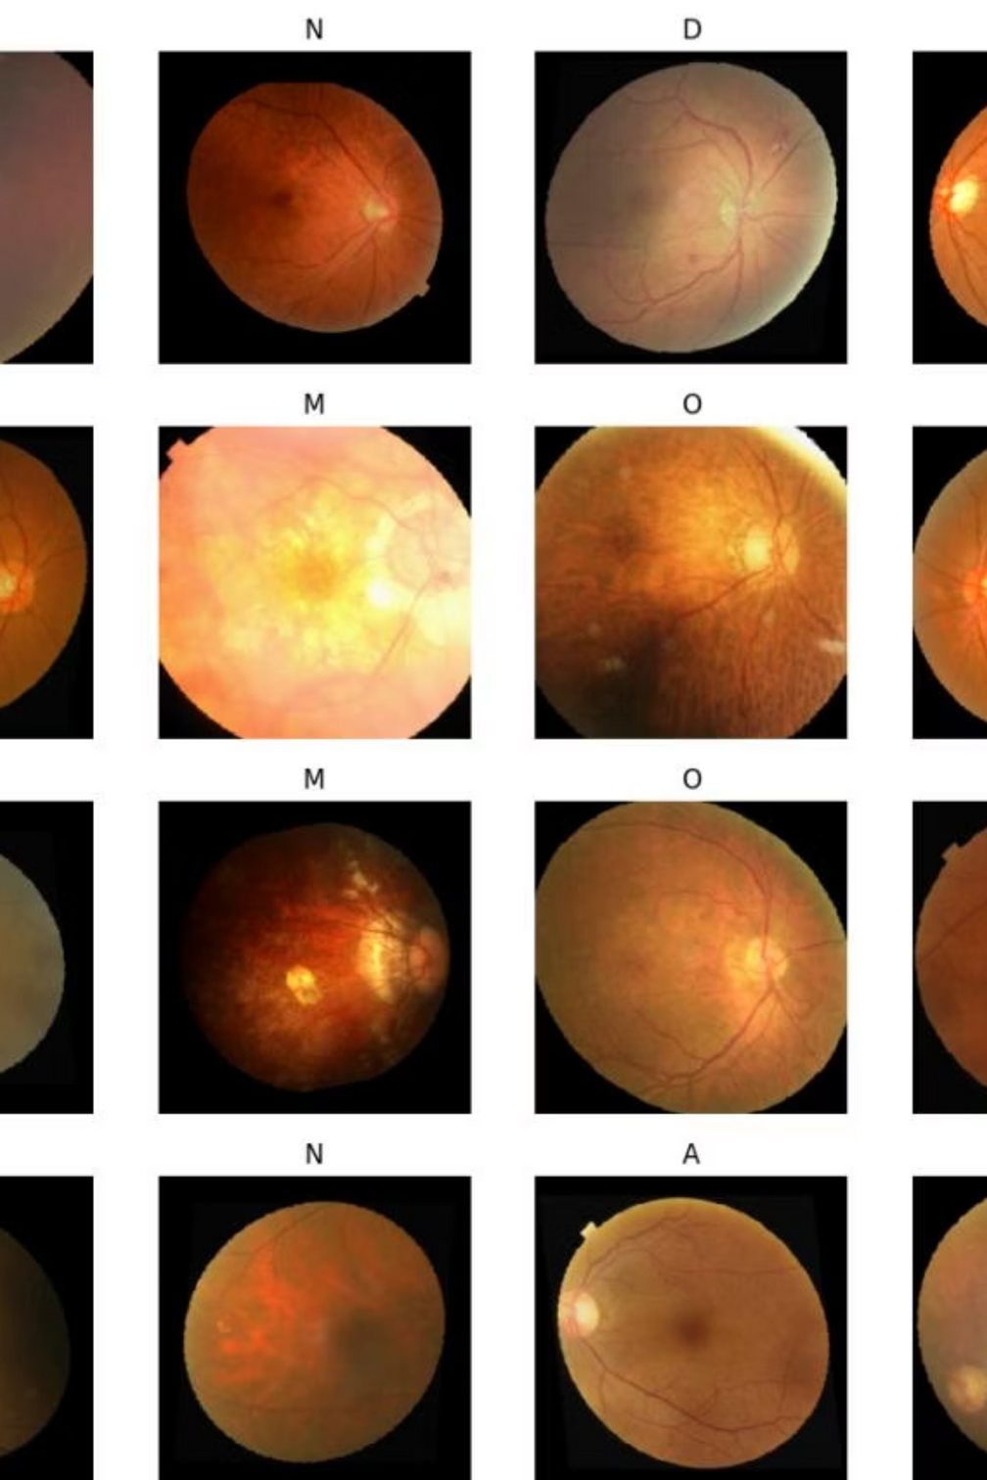

Background & Motivation
Why Retinal Disease Classification?
Manual Screening Challenges
Leading cause of blindness globally
Time-consuming
Prone to human error
Early detection is critical
Not scalable for mass screening
Our Solution
Automated CNN-based classification model for efficiency and accuracy.
Notes:
3

Slide 5



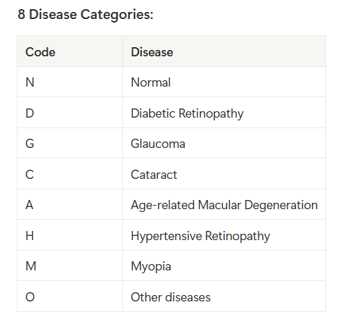
Problem Definition: Multi-Class Image Classification
Input
Model
Output
Retinal Fundus Image
(RGB 256×256)
CNN Model
Disease Class (1 of 8 categories)
Notes:
4

Slide 6
Inputs and Outputs
Notes:
2

Slide 7
Input & Output Specifications
Raw Input
Model Output
Retinal fundus images (JPG/PNG)
8-dimensional probability vector
Variable resolution
Softmax activated, sums to 1.0
RGB color space
Final Prediction
Preprocessed Input
Class with highest probability
Resized to 256×256 pixels
Confidence score (%)
Normalized
Example: Prediction: G (Glaucoma), Confidence: 87%
Tensor shape: [Batch, 3, 256, 256]
Notes:
6

Slide 8
Data Preparation & Visualization
Notes:
2

Slide 9
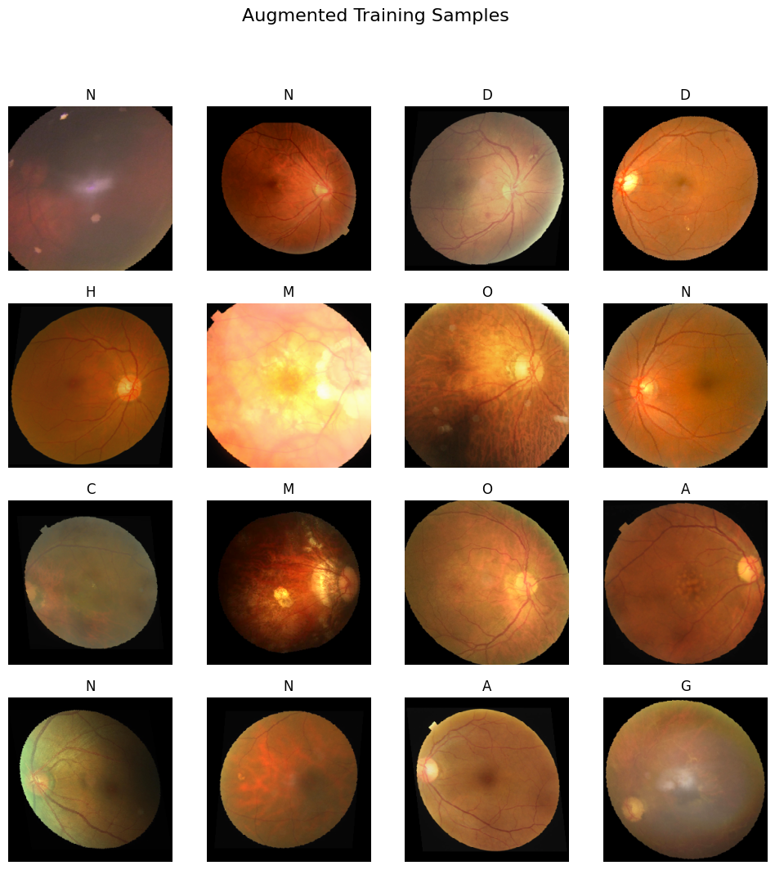
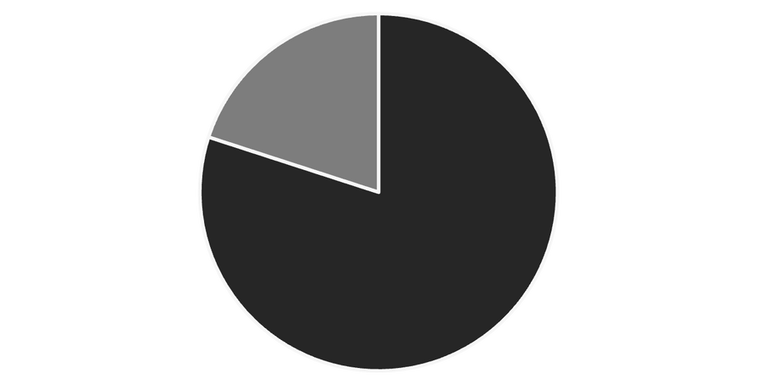
Dataset Overview
Dataset Statistics
Total images: 9,868
Format: JPG/PNG
Classes: 8 disease categories
Training (80%)
Validation (20%)
Notes:
7

Slide 10
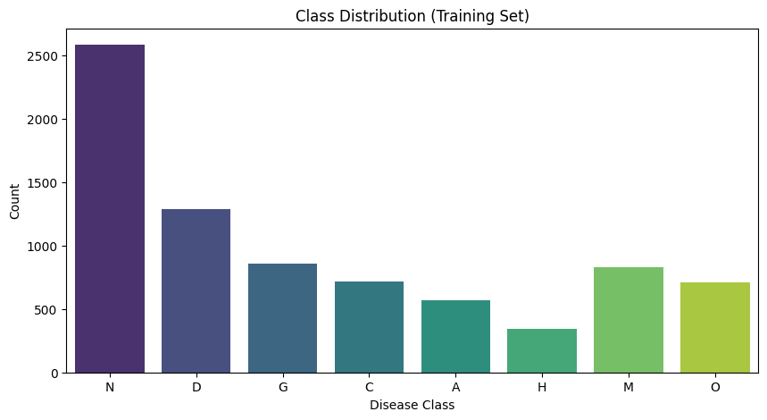
Class Distribution
⟶ Imbalance Ratio
Notes:
7

Slide 11

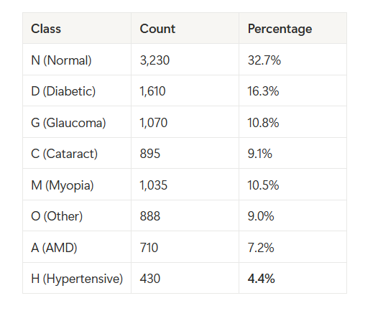



Key Challenges in Classification
Severe Class Imbalance
Ratio: 7.5:1 (Normal vs. Hypertensive)
Inter-class Similarity
Vascular diseases share visual features, making differentiation difficult.
Heterogeneous "Other" Category
Diverse conditions grouped, complicating classification.
Limited Training Data
Some classes have fewer than 5%.
Notes:
5

Slide 12
Data Augmentation Pipeline
Training Transforms: Increase data diversity and prevent overfitting.
Original Image
1
2
Horizontal Flip
p=0.5 (Retina symmetry)
Vertical Flip
3
p=0.5 (Orientation invariance)
4
Rotation
±20° (Camera angle variation)
Color Jitter
5
±0.2 (Lighting differences)
6
Affine
scale 0.8-1.2 (Size variation)
ToTensor & Normalize
7
Notes:
8

Slide 13
Optimization Techniques Analysis
Notes:
2

Slide 14

Class Imbalance Handling
1
Weighted Cross-Entropy Loss
Minority class errors are penalized more.
Normal (N): 0.38 (down-weighted)
Hypertensive (H): 2.87 (up-weighted)
2
Label Smoothing (ε=0.1)
Prevents overconfident predictions and improves model calibration.
Hard Labels → Soft Labels
Notes:
9

Slide 15





Additional Optimization Techniques
LR Scheduling
ReduceLROnPlateau (factor=0.2, patience=2)
Early Stopping
Patience=5, monitor F1-Score
Mixed Precision
FP16 training for faster speed and less memory
Test-Time Augmentation (TTA)
Averaged 3 versions, +0.73% F1 improvement
Notes:
10

Slide 16
Neural Network Model Architecture
Notes:
2

Slide 17
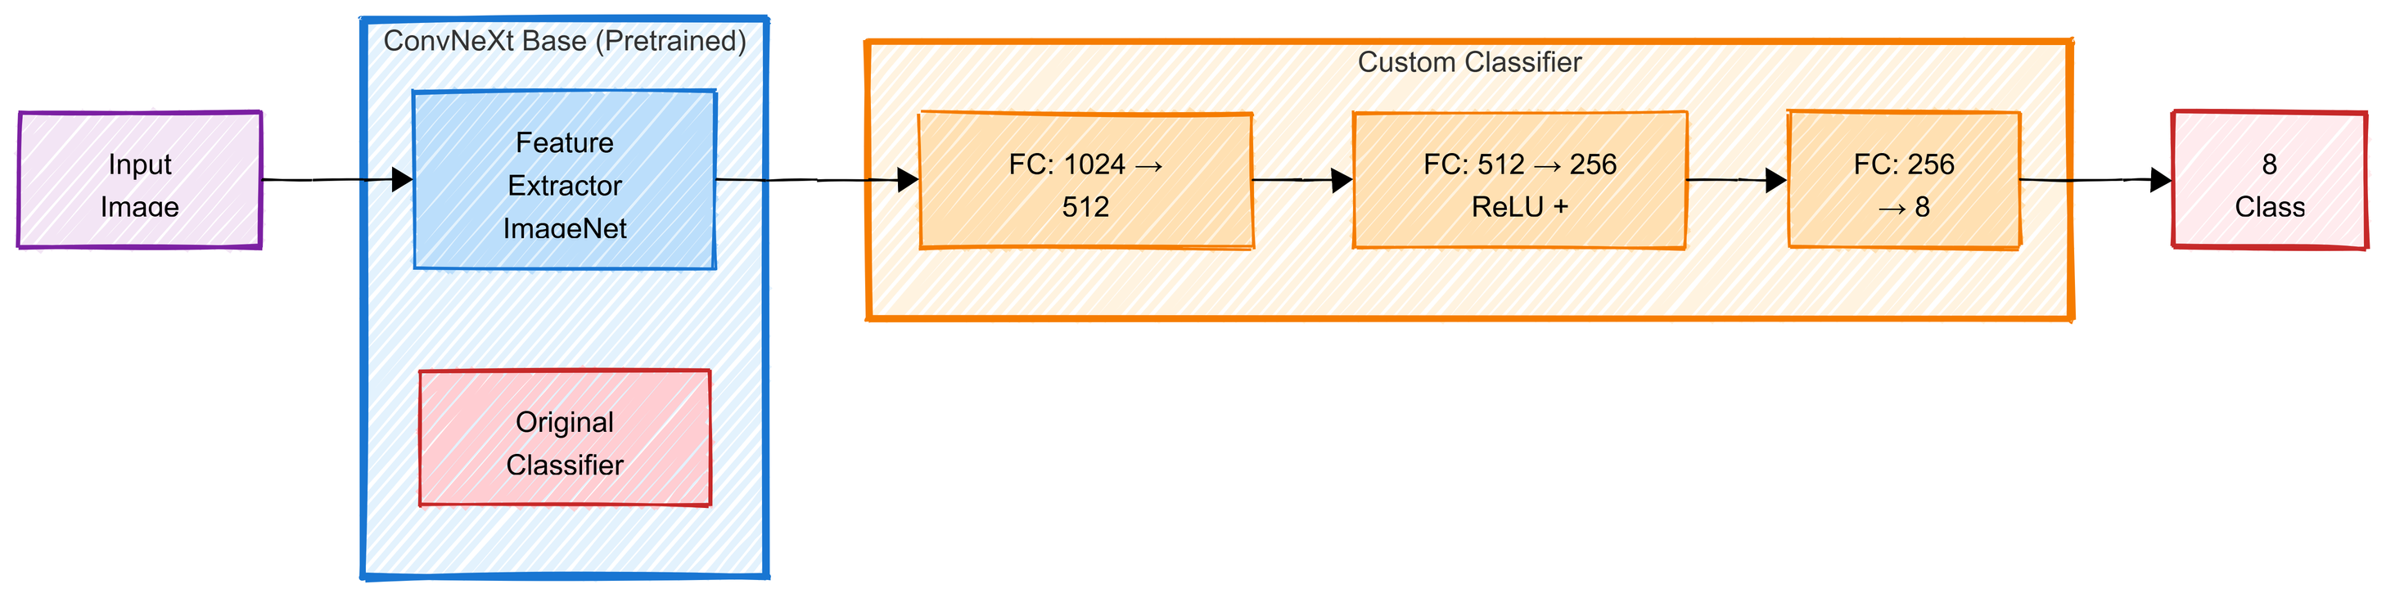
Neural Network Model Architecture
Backbone: ConvNeXt Base (ImageNet pre-trained)
Custom Head: 1024 → 512 → 256 → 8 classes
Regularization: Dropout (0.4, 0.3) + Label Smoothing (0.1)
Total Params: 88.2M trainable parameters
Notes:
2

Slide 18
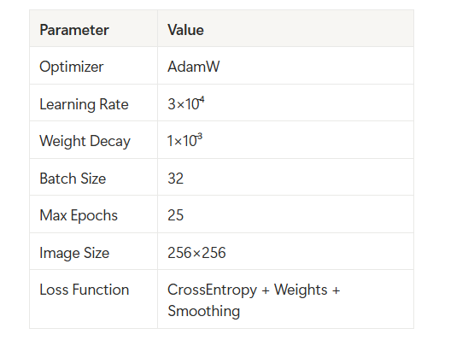
Training Configuration

Slide 19
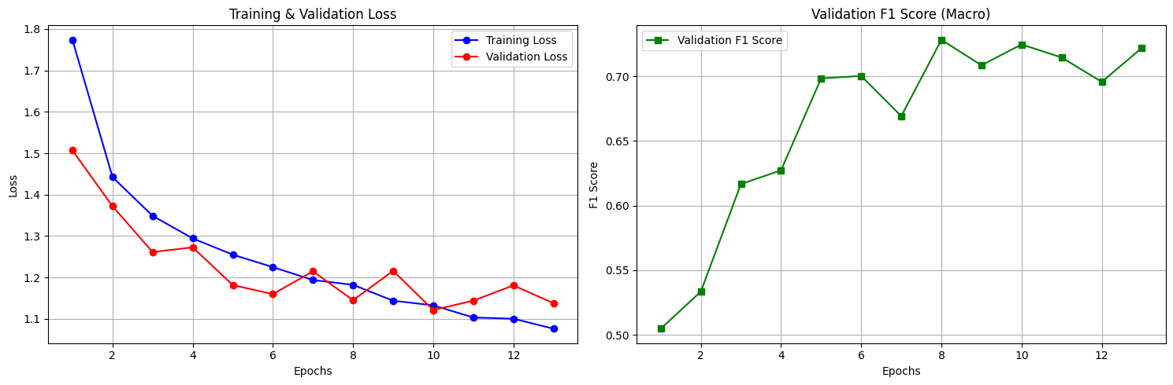
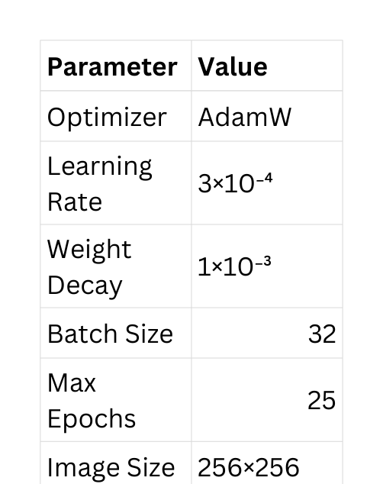
Training Process
Key Observations:
Rapid convergence in first 5 epochs
Best model at epoch 8 (F1=0.7282)
Early stopping at epoch 13
LR reduced at epoch 13 (3e-4 → 6e-5)
Notes:
2

Slide 20
Performance Evaluation
Notes:
2

Slide 21
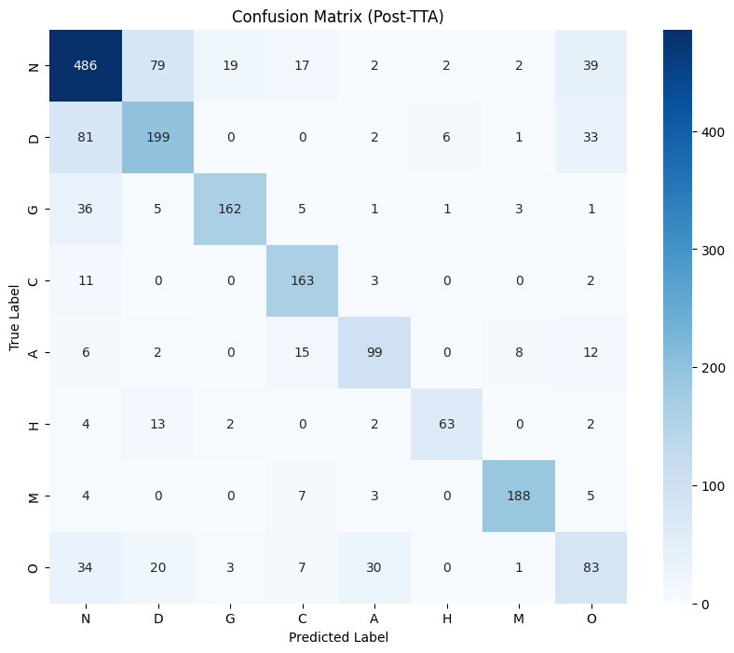
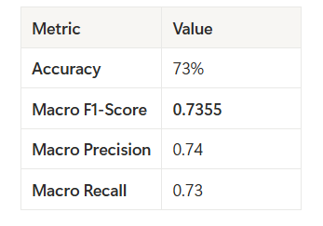
Overall Metrics (With Test-Time Augmentation (TTA))
Key Patterns:
Strong diagonal = correct predictions
Off-diagonal = misclassifications
Notable confusions: N↔︎O, D↔︎H
Notes:
2

Slide 22
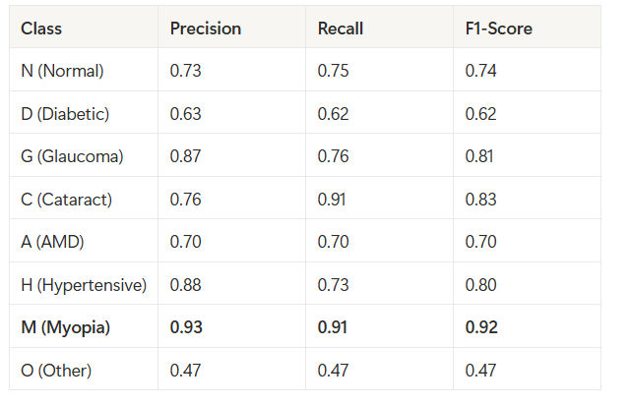
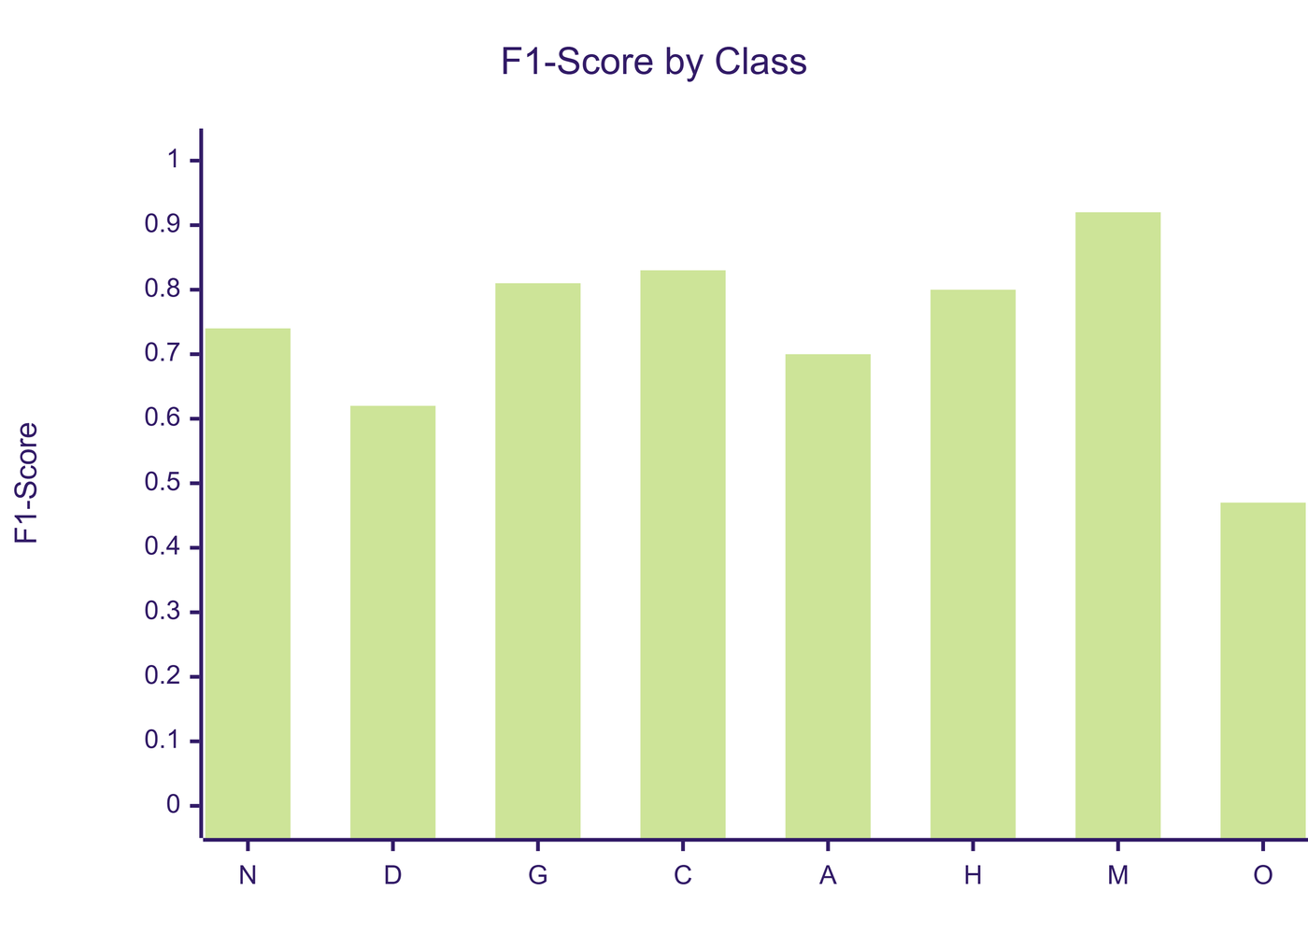
Per-Class Performance

Slide 23
Performance Analysis
Best Performing:
Myopia (F1=0.92): Distinctive elongated features
Cataract (F1=0.83): Clear lens clouding patterns
Glaucoma (F1=0.81): Optic disc changes
Most Challenging:
Other (F1=0.47): Heterogeneous category
Diabetic (F1=0.62): Overlaps with vascular diseases
Class Weights Effectiveness:
Hypertensive: 86 samples → 0.80 F1 (success!)

Slide 24
Inference on New Data
Notes:
2

Slide 25
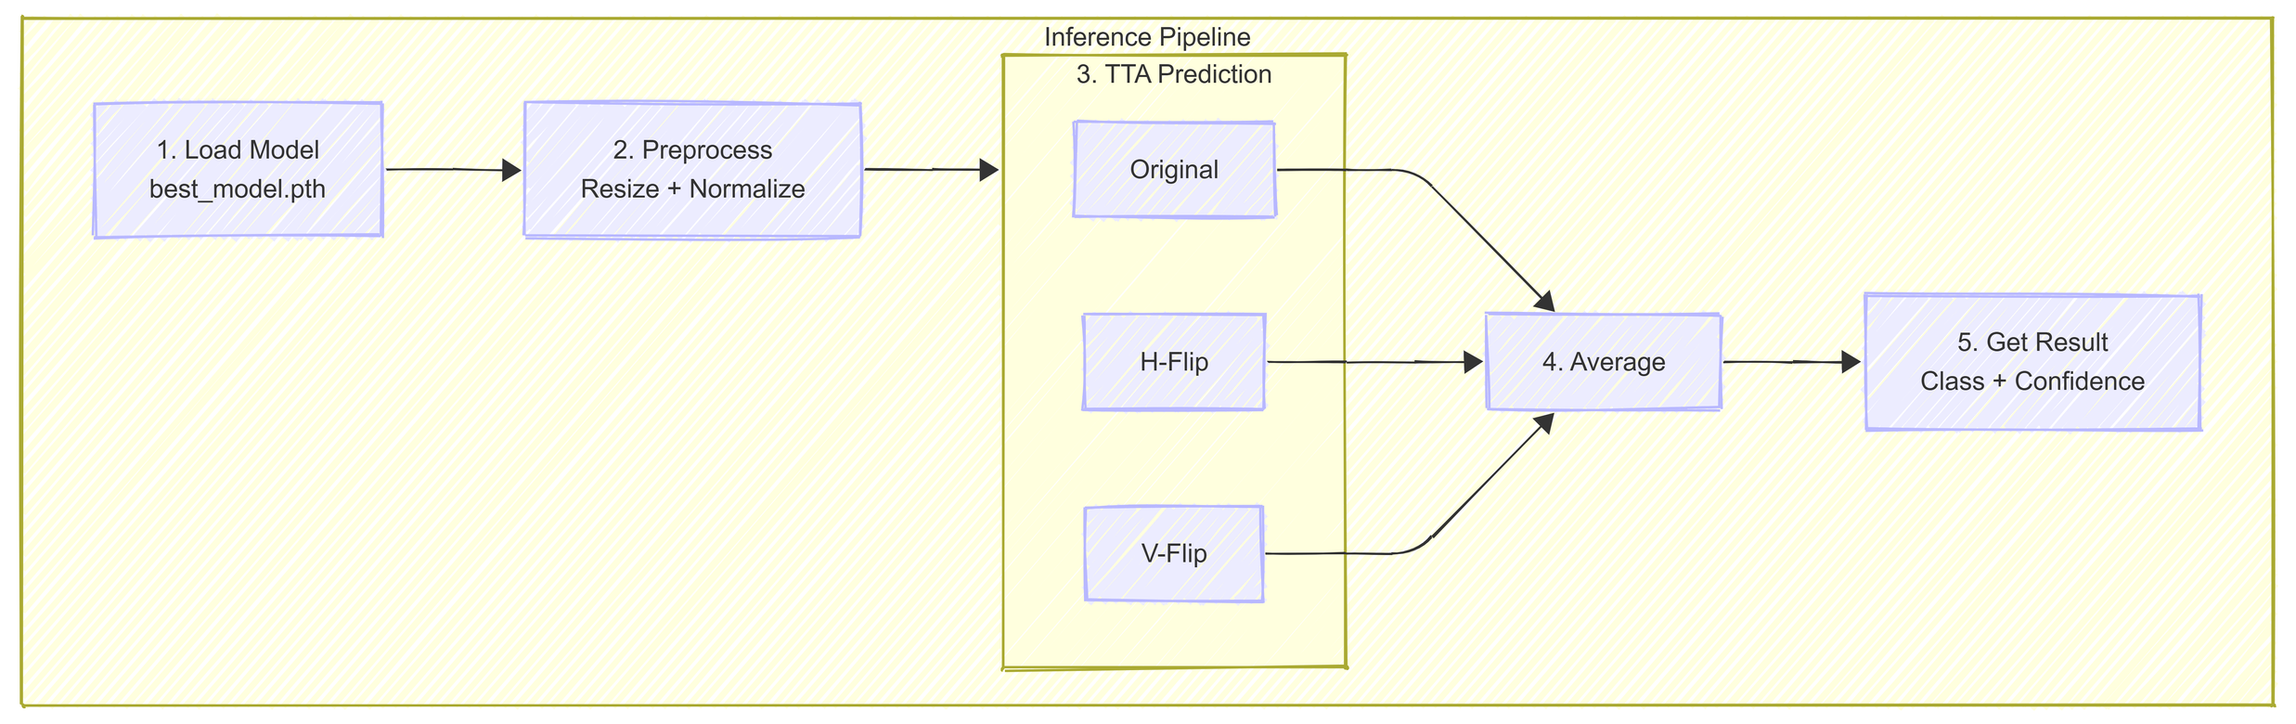
Inference Pipeline
Notes:
2

Slide 26
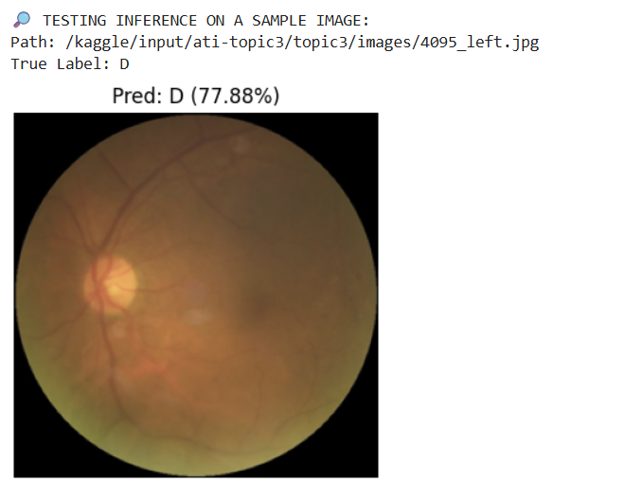
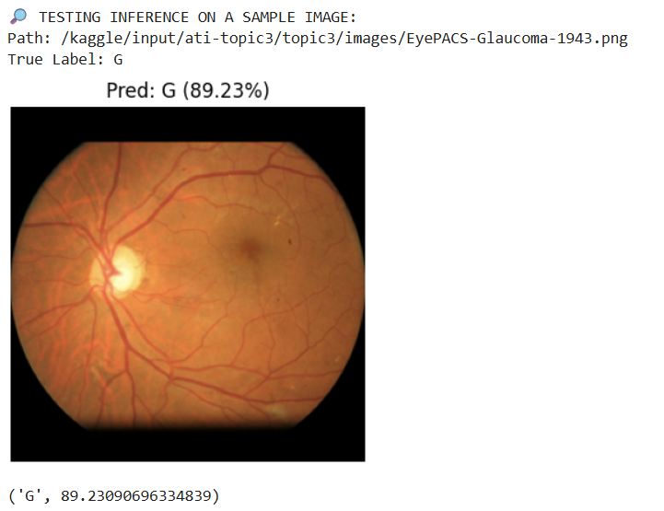
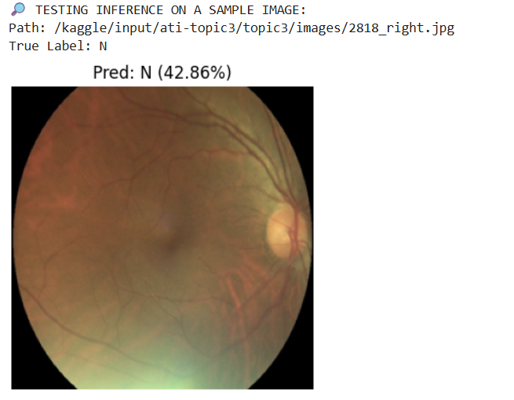
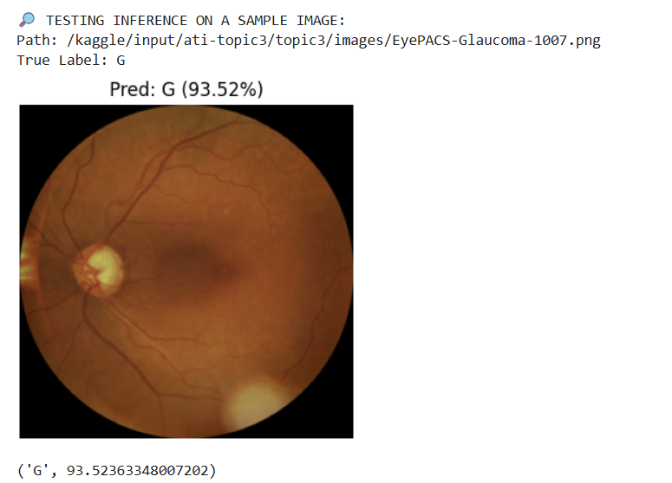

Slide 27
Conclusion
Notes:
2

Slide 28
Successfully Developed:
CNN-based retinal disease classifier
8-class multi-label classification
Handles severe class imbalance (7.5:1)
Performance:
73% accuracy
0.7355 Macro F1-Score
Balanced performance across classes
Key Techniques:
ConvNeXt-Base with transfer learning
Data augmentation + Class weighting
Label smoothing + TTA

Slide 29
Thank You!
Notes:
2

